Slide 1

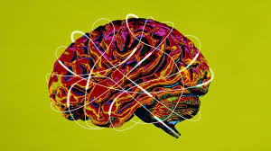

Slide 2
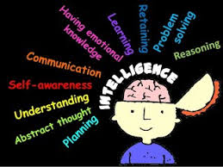
At various points throughout recent history, researchers have proposed some different definitions of intelligence.
While these definitions can vary considerably from one theorist to the next, current conceptualizations tend to suggest that intelligence is the ability to:

Slide 3
Intelligence involves some different mental abilities including logic, reasoning, problem-solving, and planning.
While the subject of intelligence is one of the largest and most heavily researched, it is also one of the topics that generate the greatest controversy.
Nature vs. Nurture: The debate over whether intelligence is primarily influenced by genetics (nature) or environmental factors (nurture).

Slide 4
Types of intelligence
1) FLUID INTELLIGENCE
Fluid intelligence It reflects our ability to reason effectively, identify patterns, and recognize relationships between concepts.
fluid Intelligence that reflects the ability to reason abstractly
Fluid intelligence encompasses the ability to reason conceptually and abstractly
Eg. If we were asked to solve an analogy, group a series of letters according to some criterion or remember a set of numbers, we would be using fluid intelligence. We use fluid intelligence when we’re trying to rapidly solve a puzzle
( mobile lock pattern )

Slide 5
2) Crystallized intelligence
Crystallized intelligence is the accumulation of information, knowledge, and skills that people have learned through experience and education & that they can apply in problem-solving situations.
It reflects our ability to call up information from long-term memory. We would be likely to rely on crystallized intelligence .
For instance, if we were asked to participate in a discussion about solution to causes of poverty, a task that allows us to draw on our own past experiences & knowledge of world.

Slide 6
In contrast to fluid intelligence, which reflects a more general kind of intelligence, crystallized intelligence is more a reflection of culture in which a person is raised.
The differences between fluid intelligence & crystallized intelligence become especially evident in late adulthood, when people show declines in fluid, but not crystallized, intelligence

Slide 7
Theories /Approaches of Intelligence
Different researchers have proposed a variety of theories to explain the nature of intelligence. Here are some of the major theories of intelligence that have emerged during the last 100 years.
Is intelligence a single, general ability, or is it multifaceted and related to specific abilities?

Slide 8
General Intelligence
British psychologist Charles Spearman (1863–1945) described a concept he referred to as general intelligence or the g factor.
g or g -factor The single, general factor for mental ability assumed to underlie intelligence in some early theories of intelligence

Slide 9
General Intelligence
Early psychologists interested in intelligence assumed that there was a single, general factor for mental ability, which they called g, or the g-factor.
This assumption was based on the fact that different types of measures of intelligence, whether they focused on, say, mathematical expertise, verbal competency, or spatial visualization skills, all ranked test-takers in roughly the same order.
People who were good on one test generally were good on others; those who did poorly on one test tended to do poorly on others.

Slide 10
Theory of Multiple Intelligences
One of the more recent ideas to emerge is Howard Gardner's theory of multiple intelligences.
He has taken an approach very different from traditional thinking about intelligence.
Gardner argues that we have a minimum eight different forms of intelligence, each relatively independent of the others:

Slide 11
Bodily-kinesthetic intelligence: The ability to control your body movements and to handle objects skillfully ( dancer , dram artists, athletics, surgeons )
Interpersonal intelligence: The capacity to detect and respond appropriately to the moods, motivations, and desires of others (
Intrapersonal intelligence: The capacity to be self-aware and in tune with inner feelings, values, beliefs, and thinking processes
Logical-mathematical intelligence: The ability to think conceptually and abstractly, and the capacity to discern logically or numerical patterns

Slide 12
Musical intelligence: The ability to produce and appreciate rhythm, pitch, and timbre
Naturalistic intelligence: The ability to recognize and categorize animals, plants, and other objects in nature
Verbal-linguistic intelligence: Well-developed verbal skills and sensitivity to the sounds, meanings, and rhythms of words
Visual-spatial intelligence: The capacity to think in images and pictures, to visualize accurately and abstractly
furthermore, he suggests that there may be even more types of intelligence, such as existential intelligence, which involves identifying and thinking about the fundamental questions of human existence

Slide 13
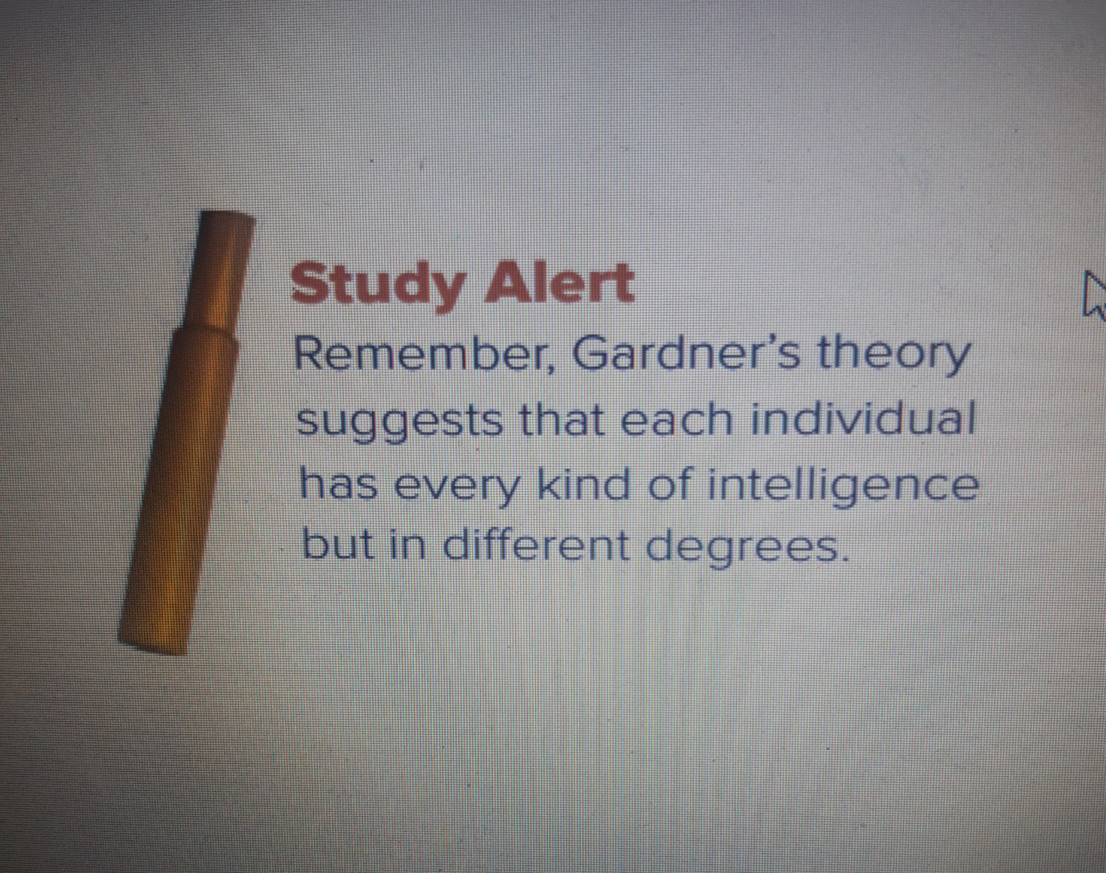

Slide 14
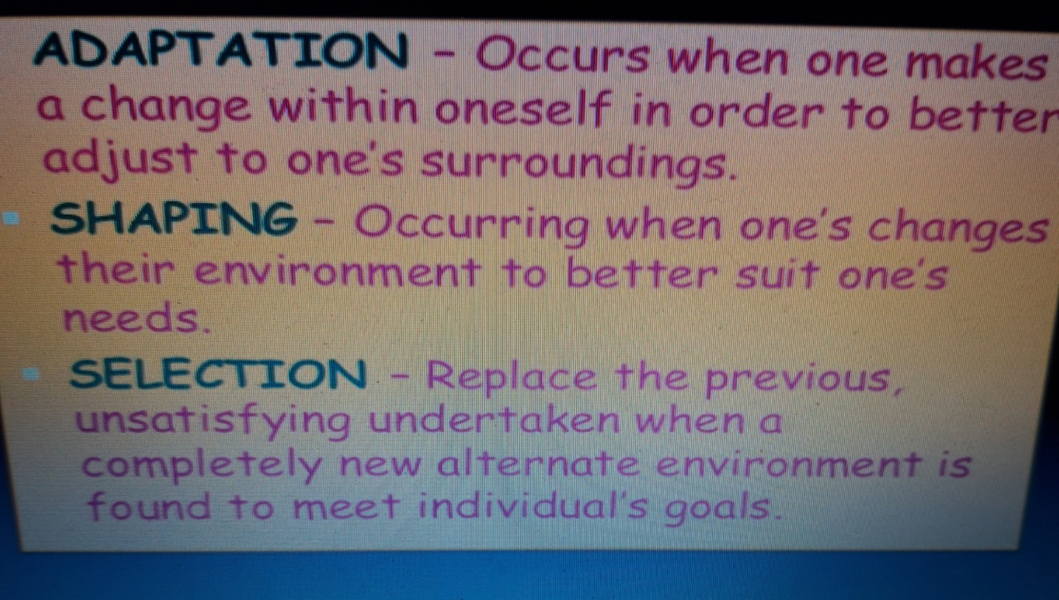
Triarchic Theory of Intelligence by Robert Sternberg
Intelligence is a "mental activity directed toward purposive adaptation to, selection, and shaping of real-world environments relevant to one's life.“

Slide 15
successful intelligence
While he agreed with Gardner that intelligence is much broader than a single, general ability. Sternberg proposed what he referred to as "successful intelligence," which involves three different factors:
Analytical intelligence (focuses on planning, monitoring, reflection and transfer. Being able to see the solutions) Analytical intelligence: Your ability to evaluate information and solve problems.
Creative intelligence Creative intelligence: Your ability to come up with new ideas.
Practical intelligence Practical intelligence: Your ability to adapt to a changing environment

Slide 16
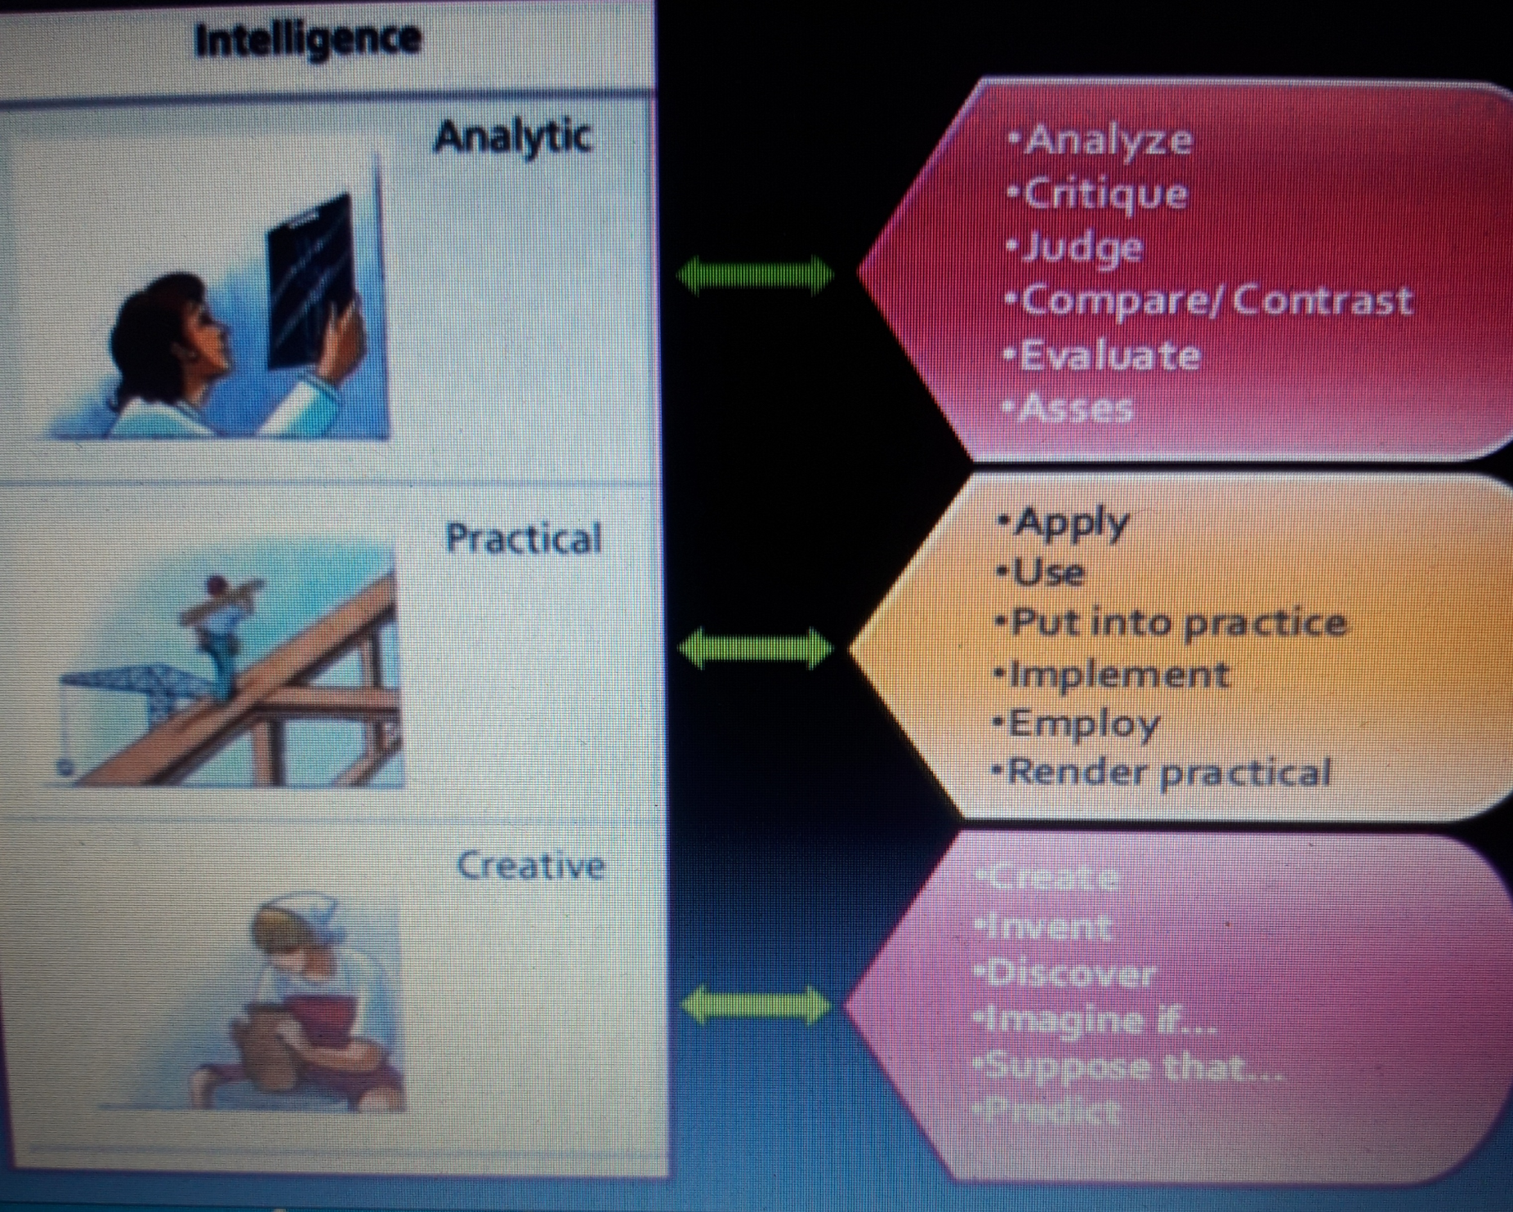

Slide 17
Assessing Intelligence
Historically an idea was put forward by Sir Francis Galton (1822–1911), an eminent English scientist
The first effort at intelligence testing was based on an uncomplicated but completely wrong assumption:
that the size and shape of a person’s head could be used as an objective measure of intelligence.
Galton’s theories were proved wrong on virtually every count. Head size and shape are not related to intellectual performance, and subsequent research has found little relationship between brain size and intelligence

Slide 18
BINET AND THE DEVELOPMENT OF IQ TESTS
Psychologist Alfred Binet developed the very first intelligence tests to help the French government identify schoolchildren who needed extra academic assistance.
Binet was the first to introduce the concept of mental age or a set of abilities that children of a certain age possess (chronological ages.)

Slide 19
Binet devised the first formal intelligence test, which was designed to identify the “dullest” students in the Paris school system in order to provide them with remedial aid.
Binet began by presenting tasks to same-age students who had been labeled “bright” or “dull” by their teachers.
If a task could be completed by the bright students but not by the dull ones, he retained that task as a proper test item; otherwise it was discarded.
In the end he came up with a test that distinguished between the bright and dull groups

Slide 20
On the basis of the Binet test, children were assigned a score relating to their mental age,
the age for which a given level of performance is average or typical.
For example, if the average 8-year-old answered, say, 45 items correctly on a test, anyone who answered 45 items correctly would be assigned a mental age of 8 years. Consequently, whether the person taking the test was 20 years old or 5 years old, he or she would have the same mental age of 8 years (Cornell, 2006).

Slide 21
intelligence quotient (IQ),
Intelligence quotient (IQ), a measure of intelligence that takes into account an individual’s mental and chronological (physical) age.
Historically, the first IQ scores employed the following formula in which MA stands for mental age and CA for chronological age:
IQ score = MA /CA x100
As a bit of trial and error with the formula will show you, anyone who has a mental age equal to his or her chronological age will have an IQ equal to 100. (which is average)
Moreover, people with a mental age that is lower than their chronological age will have IQs that are lower than 100

Slide 22
The intellectually gifted
The intellectually gifted are people with IQ scores greater than 130. Intellectually gifted people tend to be healthier and more successful than the nongifted
intellectually gifted The 2%–4% segment of the population who have IQ scores greater than 130.

Slide 23
INTELLECTUAL DISABILITIES (MENTAL RETARDATION)
Intellectual disability (or mental retardation as it was more traditionally called) occurs in 1%–3% of the population.

Slide 24
Down syndrome
Down syndrome is a genetic disorder caused when abnormal cell division results in an extra full or partial copy of chromosome . In most cases, there is an extra copy of the 21st chromosome, which leads to problems in how the brain and body develop
This extra genetic material causes the developmental changes and physical features of Down syndrom
It represents another major cause of intellectual disabilities. Down syndrome results when a person is born with 47 chromosomes instead of the usual 46. (Humans have 23 pairs of chromosomes, for a total of 46 chromosomes )

Slide 25
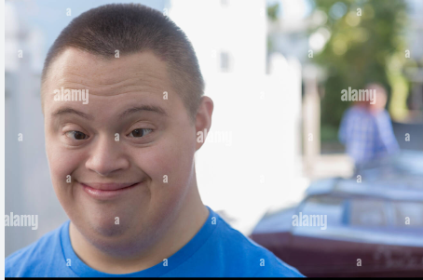

Slide 26
IDENTIFYING THE ROOTS OF INTELLECTUAL DISABILITIES
The most common preventable cause of intellectual disabilities is fetal alcohol syndrome, produced by a mother’s use of alcohol while pregnant.
Increasing evidence shows that even small amounts of alcohol intake can produce intellectual deficits

Slide 27
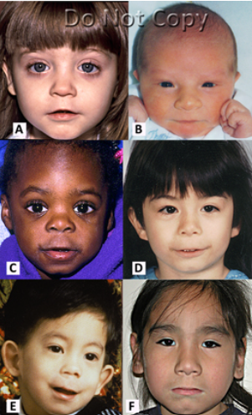
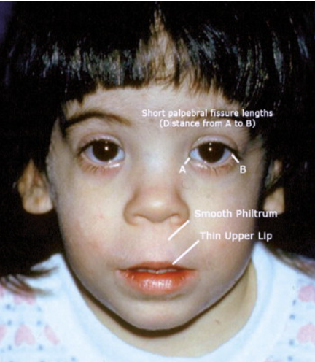

Slide 28
IDENTIFYING THE ROOTS OF INTELLECTUAL DISABILITIES
In other cases of intellectual disabilities, an abnormality occurs in the structure of particular chromosomes.
Birth complications, such as a temporary lack of oxygen, may also cause retardation.
In some cases, intellectual disabilities begin after birth following a head injury, a stroke, or infections such as meningitis.

Slide 29
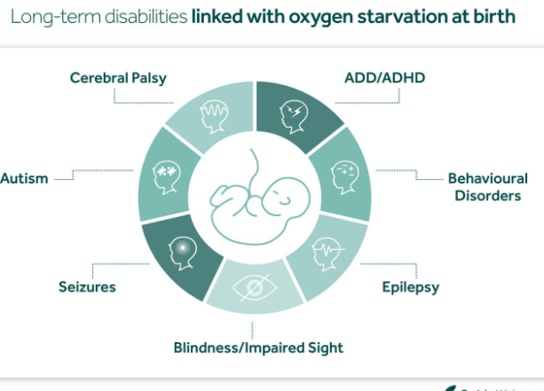

Slide 30
Symptoms of seizures include:
change of consciousness (awareness) unresponsive, staring into space. vague, numbness or tingling sensations.
Hallucinations
In adults, the main features of ADHD may include difficulty paying attention, impulsiveness and restlessness.
The main symptoms of cerebral palsy are problems with movement, co-ordination and development. delays in reaching development milestones – for example, not sitting by 8 months or not walking by 18 months. seeming too stiff or too droopy (hypotonia)

Slide 31
Signs and symptoms of autism
little or no babbling.
little or no eye contact.
showing more interest in objects than people.
appearing not to hear when spoken to directly.
playing with toys in an unusual or limited manner.
repetitive movements with their fingers, hands, arms or head.

Slide 32
One of the main differences is that Autism is a spectrum disorder, while Down Syndrome is a genetic disorder. This means that while individuals with Autism can have a wide range of symptoms and abilities, individuals with Down Syndrome typically have similar physical and intellectual characteristics

Slide 33
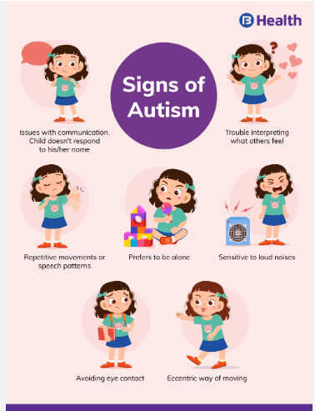

Slide 34
Thank You

